Slide 1
Unit 11: Intro to Time Series via Holt Winters

Slide 2
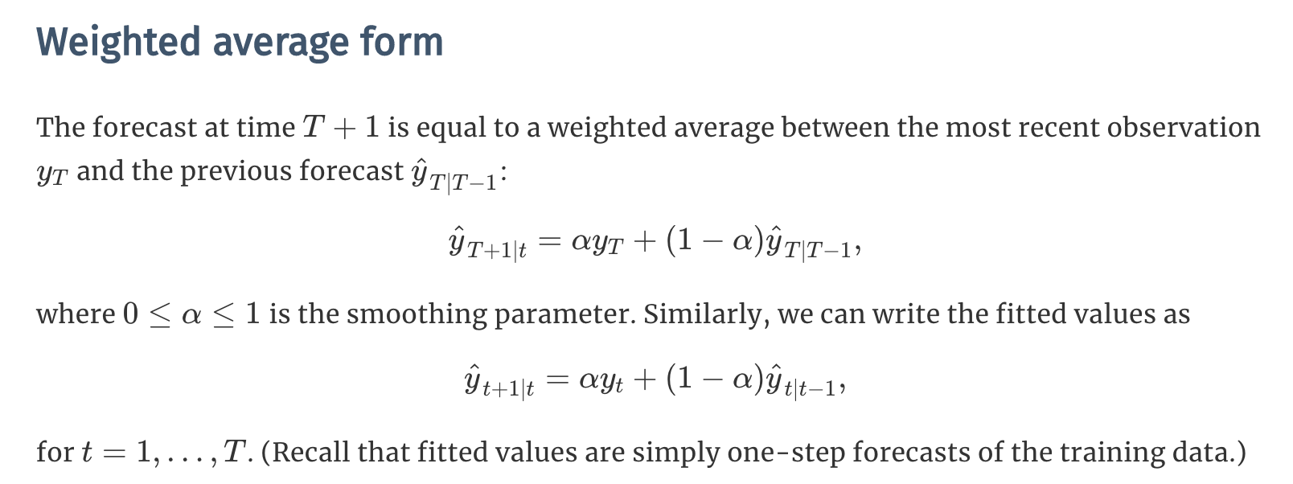
SES: Weighted Average Form

Slide 3
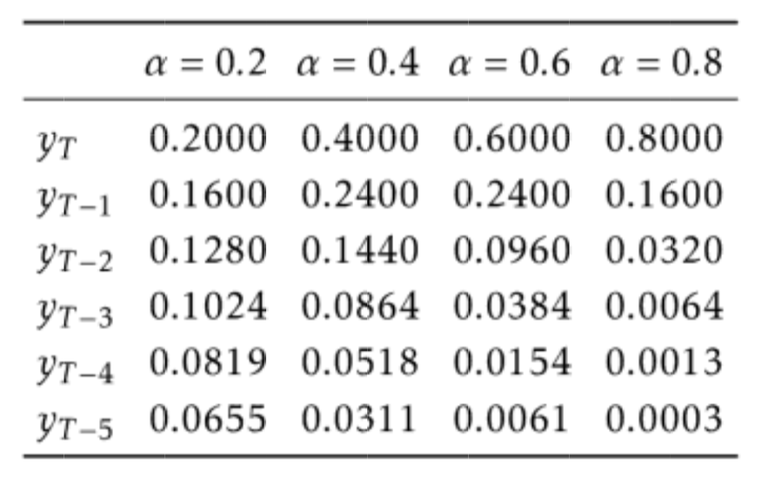
Simple Exponential Smoothing
https://robjhyndman.com/hyndsight/aic/

Slide 4
Simple Exponential Smoothing

Slide 5
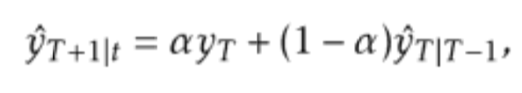

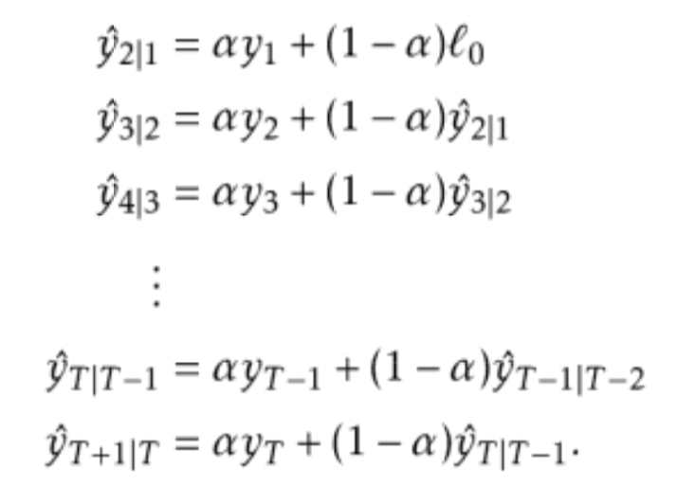
Simple Exponential Smoothing

Slide 6
Simple Exponential Smoothing

Slide 7
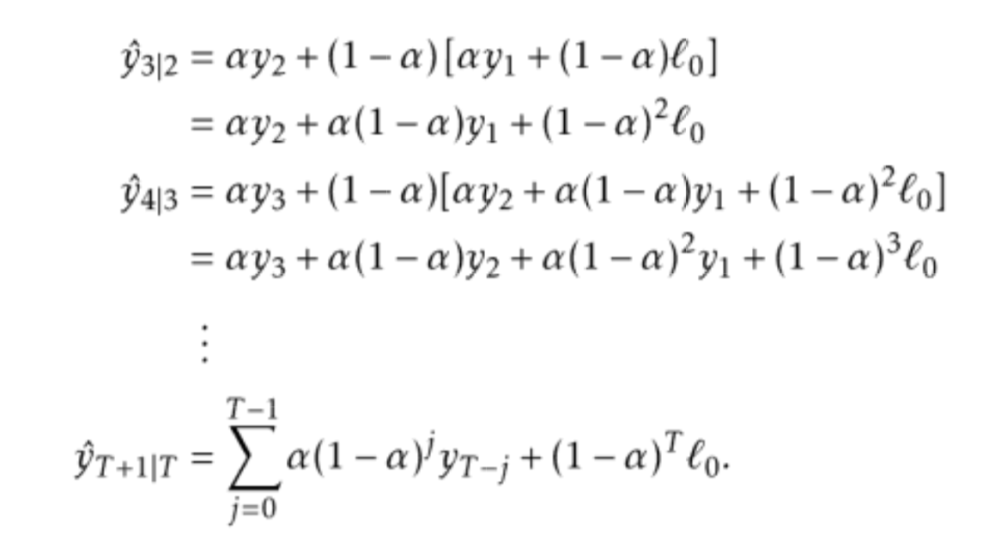
Simple Exponential Smoothing

Slide 8
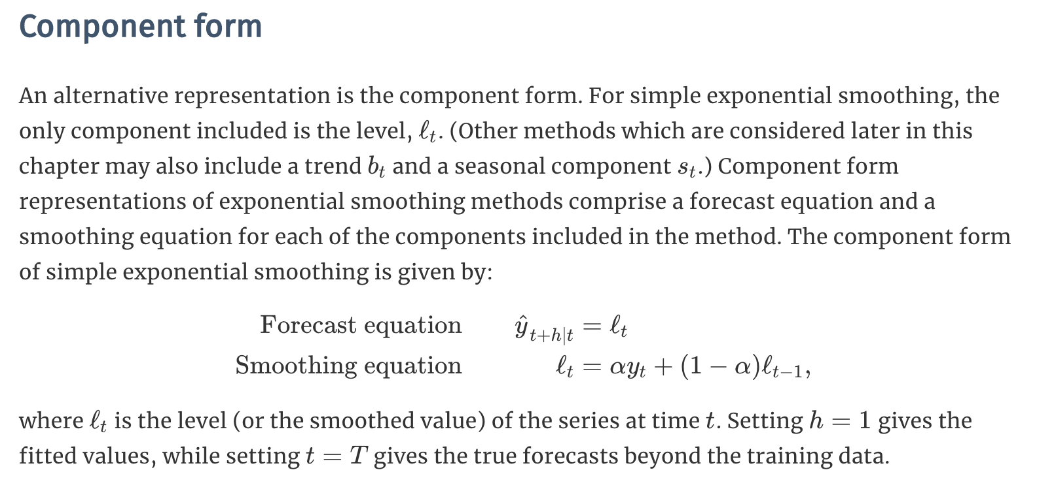
Component Form

Slide 9
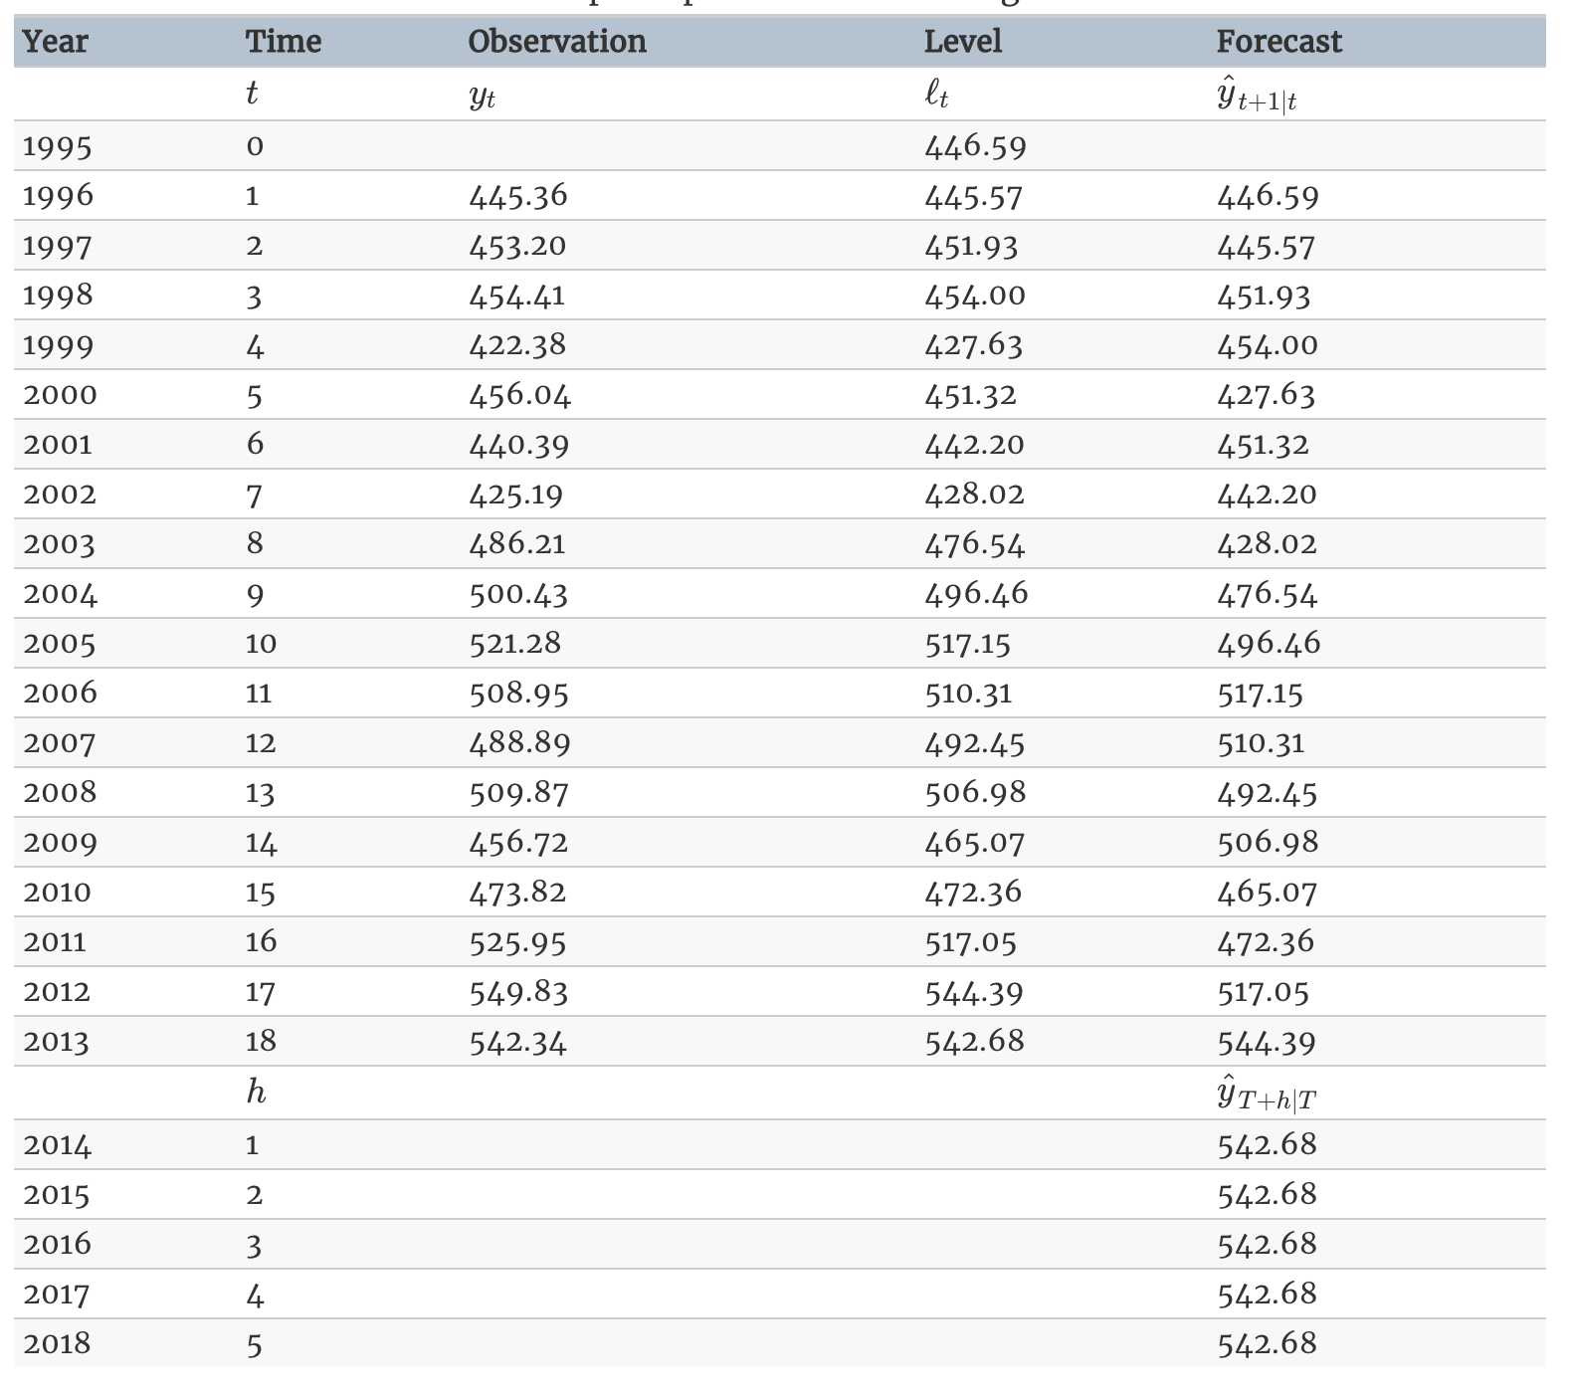
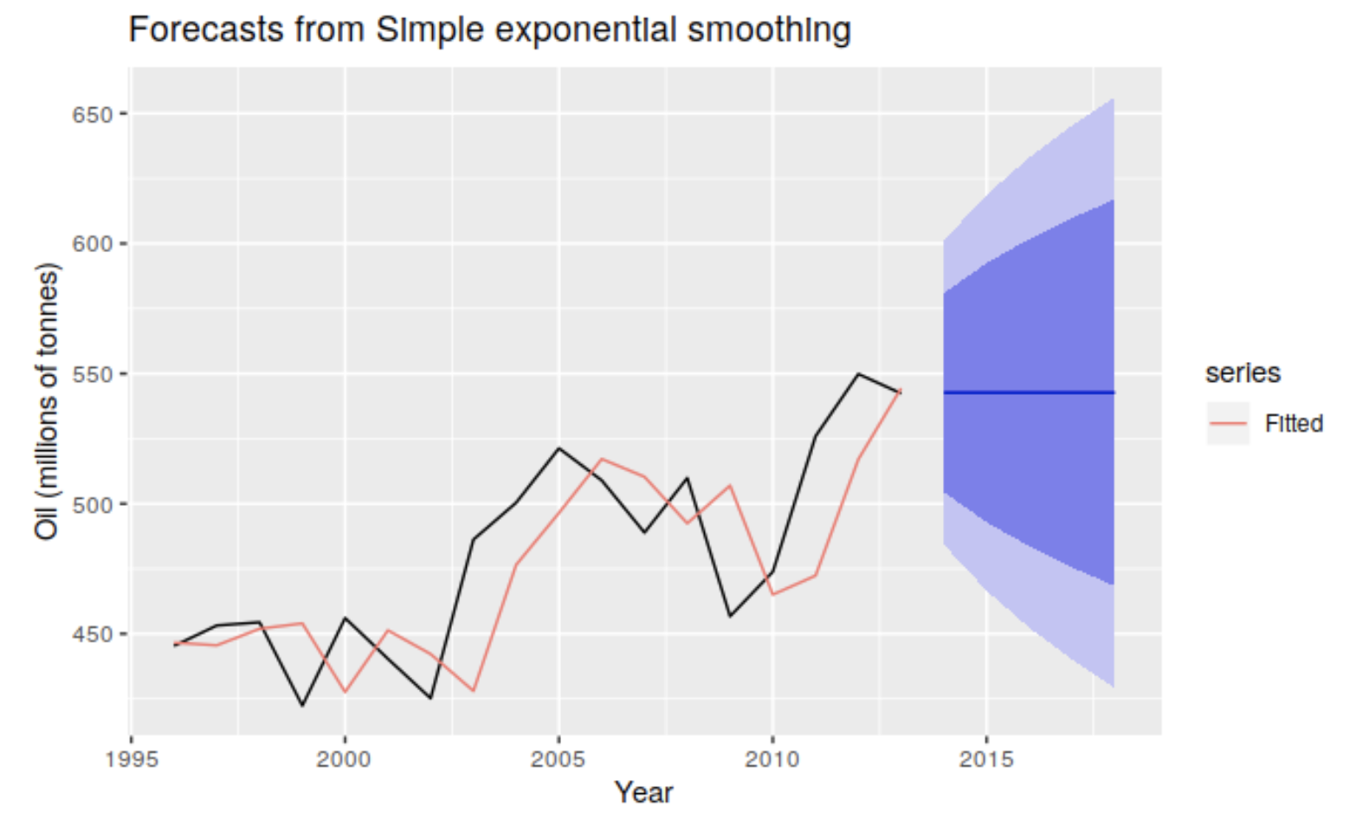
Example: SES

Slide 10
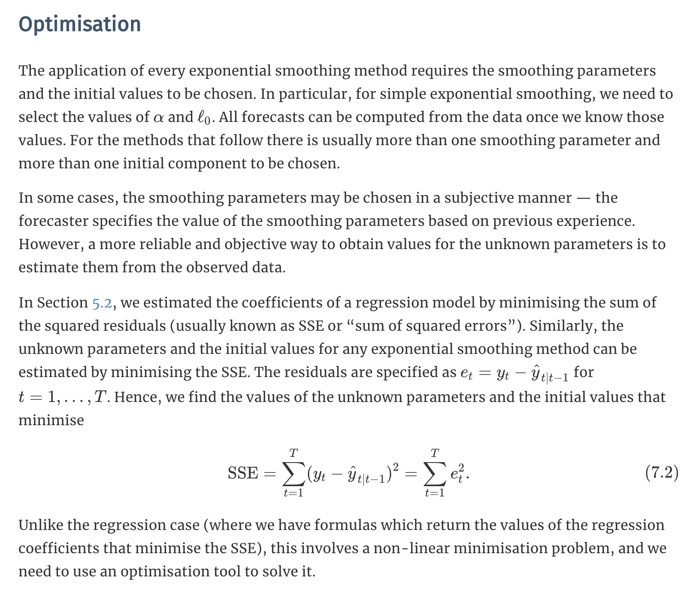
Optimization

Slide 11
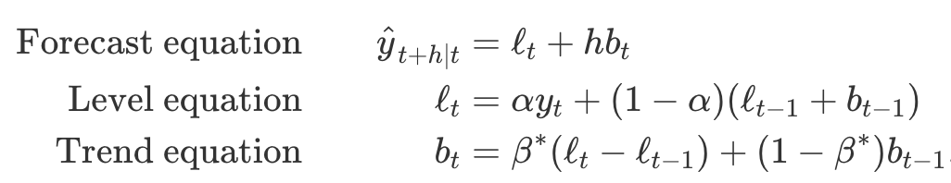
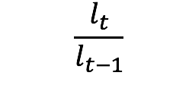

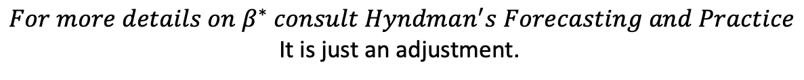
HOLT Linear Trend
Additive
Multiplicative
$${For more details on β}^{∗} consult Hyndman^{′}s Forecasting and Practice$$
It is just an adjustment.

Slide 12
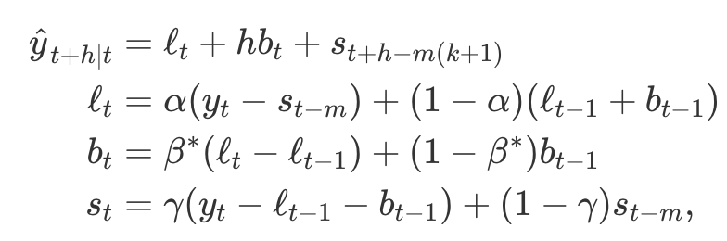
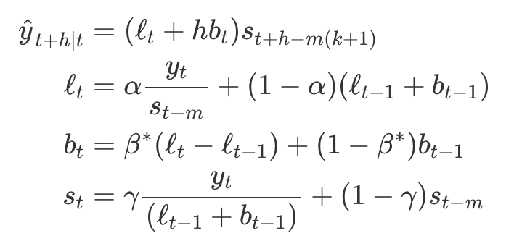
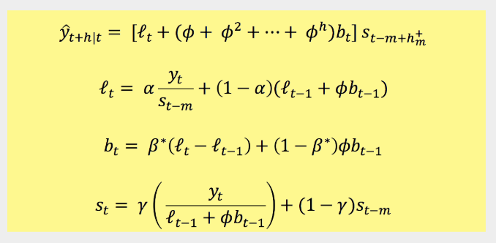
Holt Winters Seasonal Model
m = frequency of the seasonality …
m = 12 for monthly data
m = 4 for quarterly data
Additive
Multiplicative

Slide 13
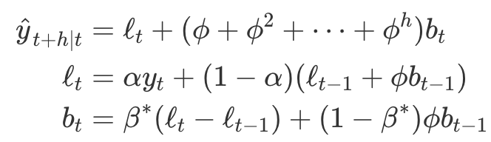
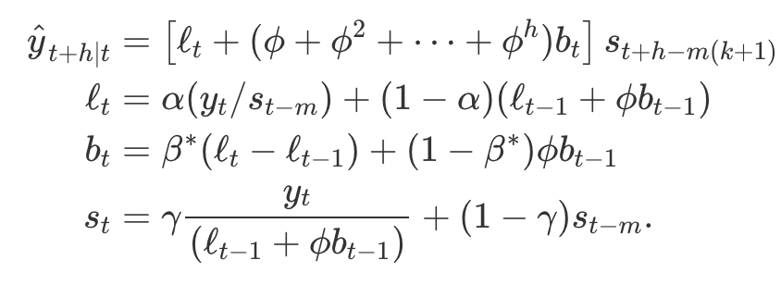
Damped Additive and Multiplicative
Damped Additive Holt
Damped Multiplicative Holt Winters

